Slide 1
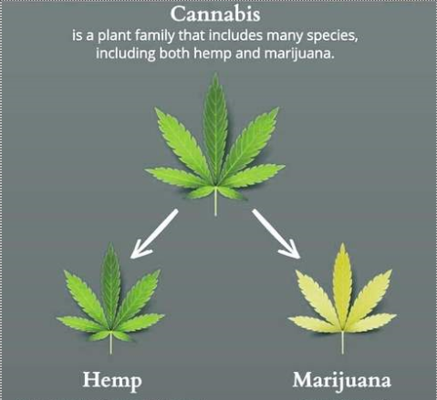
CBD
Cannabidiol (CBD) - compound found in resin flower of cannabis plants
New Policy - Effective June 6, 2019, Postal Bulletin Publication 22521
to be incorporated at a later date in Publication 52, as new Section 453.
Mailer complies with all applicable federal, state, and local laws pertaining to hemp production, processing, distribution and sales
Mailer retains records (lab test reports, licenses, compliance reports,….) no less than 2 years after date of mailing
Mailability
Mailable - Domestic and US Possessions, Territories or Freely Associated States
Non-Mailable - International and Military (APO/FPO/DPO)
Standards Available:
All Types of Postage and Product Services
Extra and Special Services
Returns – Mailer is responsible for customer’s return process
Advertisements – existing USPS policy applies. CBD and hemp derived products are mailable as long as they are not prohibited by other laws. In doubt, consult with PCSC in NY.
Questions: Mary.J.Collins@usps.gov
Notes:
Mailer’s Responsibility
Comply with the applicable laws and retain records
Know their product and apply proper packaging

